Slide 1
STUDENT LOAN MANAGEMENT SYSTEM
Subject : Object Oriented Programming
Lecture by : Mr. Chan Sophal
Dept : I3-AMSB
Group : 8
Members :
1. Sao Samarth ID:e20200084
2. Rith Chanthyda ID:e20200612
3. Phal Davy ID:e20201437
4. Pov Rathna ID:e20200082
5. Sreng Seangleng ID:e20200840
6. Rithy Vira ID:e20200978

Slide 2
Table of contents
01
02
03
Introduction
Project Process
Drawback

Slide 3
Introduction
Student Loan Management System is an application which gives information of various types of loans for students.
This application makes the progress of a student easy in providing the right way of information about education loan.

Slide 4
Project Process
Identify Task
Coding
We already planned the design of our project and set the role for each of our member
We will start working on it soon
Data Collection
System Testing
We was able to collect some data related to student loan from some bank
We will start working on it soon

Slide 5
Data Collector
Rith Chanthyda
Phal Davy
Data collector
Data Collector

Slide 6
The Data that we obtained:
Bank | Loan Type | Loan Amount (USD) | Loan Term (month) | Interest Rate(%) | Repayment Method | Document Required
Phillip Bank | Student Loan | 200-6000 | 54 | 1.35 | EMI | +Relevant financial +Bank Account +Salary Slip
Sahaka MFI | Education Loan | 5000 | 60 | Reasonable Rate | Optional | +Age 18-65 +Reliable credit +Diploma
Woori Bank | Education Loan | 5000 | 12-84 | 1.30-1.50 | Base on client’s cash flow
Acleda Bank | Student Loan | 2500 | 12 | 0.6-1.5 |  | +Address +Salary +School Fee
Prince Bank | Student Loan | 10000 | 96 | 0.6 |  | +Guarantor +Address +School Fee
Hatta Bank | Student Loan | 10000 | 84 | 1.5 | Flexible Payment
Hatha Kaksekar Limited | Student Loan | 8000 | 84 | 1.5 | Flexible
Wing Bank | Quick Loan | 50-500 | 36 | 1.5 |  | + Age 18-65 +Good credit +income +Bank Account
ABA Bank | Student Loan | Variable | 10 | 10p.a | EMI | +Tuition fee Application Form
Brasak Bank | Student Loan | 25001 | 2 | Reasonable Rate | Base on client’s cash flow | +ID card +Passport +income

Slide 7
Coding
System Design
User Function
Administration Function
Sao Samarth
Pov Rathna
Rithy Vira
Sreng Seangleng

Slide 8
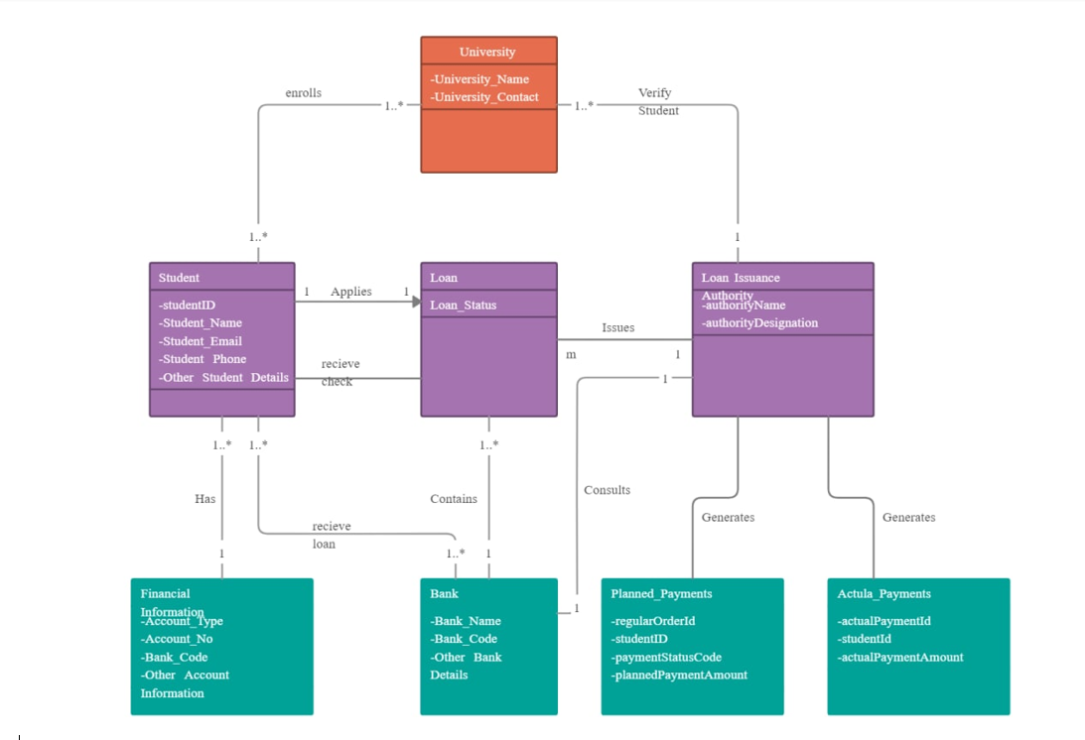
User Function Diagram

Slide 9
Administration Function Diagram
Administraion
Manage Student Info:
Create
Update
Delete
Manage Bank Info:
Loan info
Update interest rate

Slide 10
Drawback
Data Collection
Difficult to find data in local bank
Programming
Can’t figure out the method to store data yet.

